Slide 1

Classify Data Using the Classification Learner App
Presenting by pouya mehrbabak

Slide 2
نام و نام خانوادگی : پویا مهربابک
شماره دانشجویی : 940411366
موضوع : Classify Data Using the Classification Learner App
استاد نجم آبادی
کلاس شنبه ساعت 7:30

Slide 3
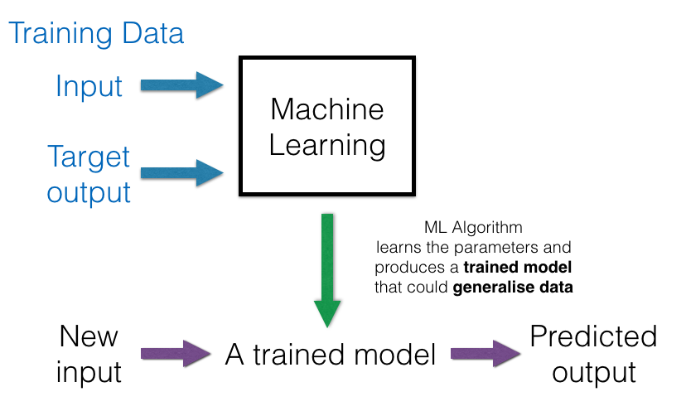
Training data

Slide 4
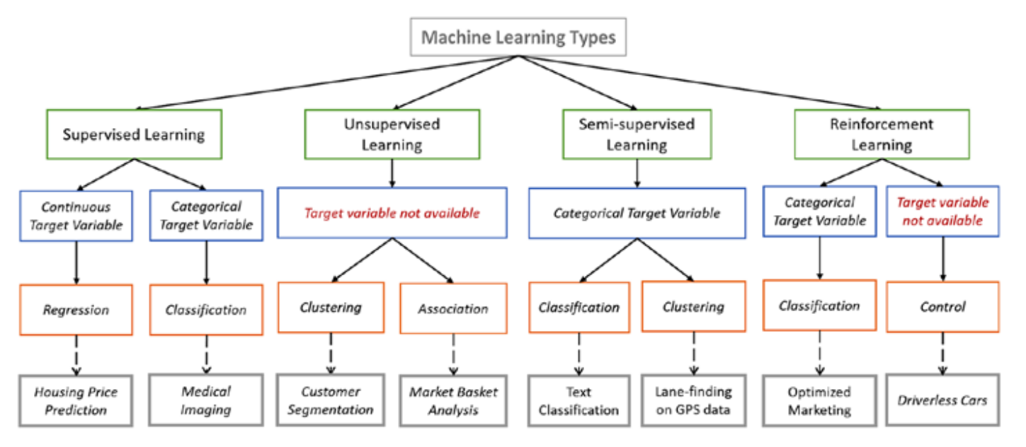
Machine learning types

Slide 5
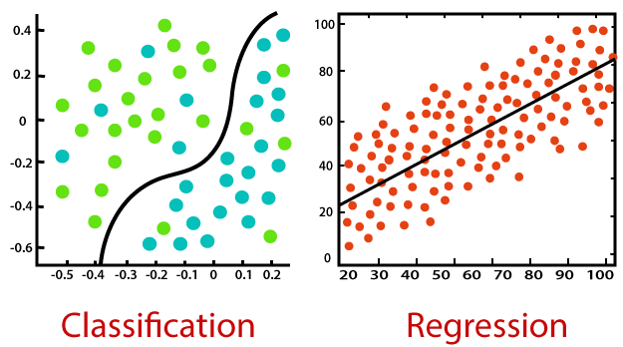
What is classification In Machine Learning ?
Classification
is a process of categorizing a given set of data into classes
It can be performed on both structured or unstructured data.
The process starts with predicting the class of given data points.
The classes are often referred to as target, label or categories.

Slide 6
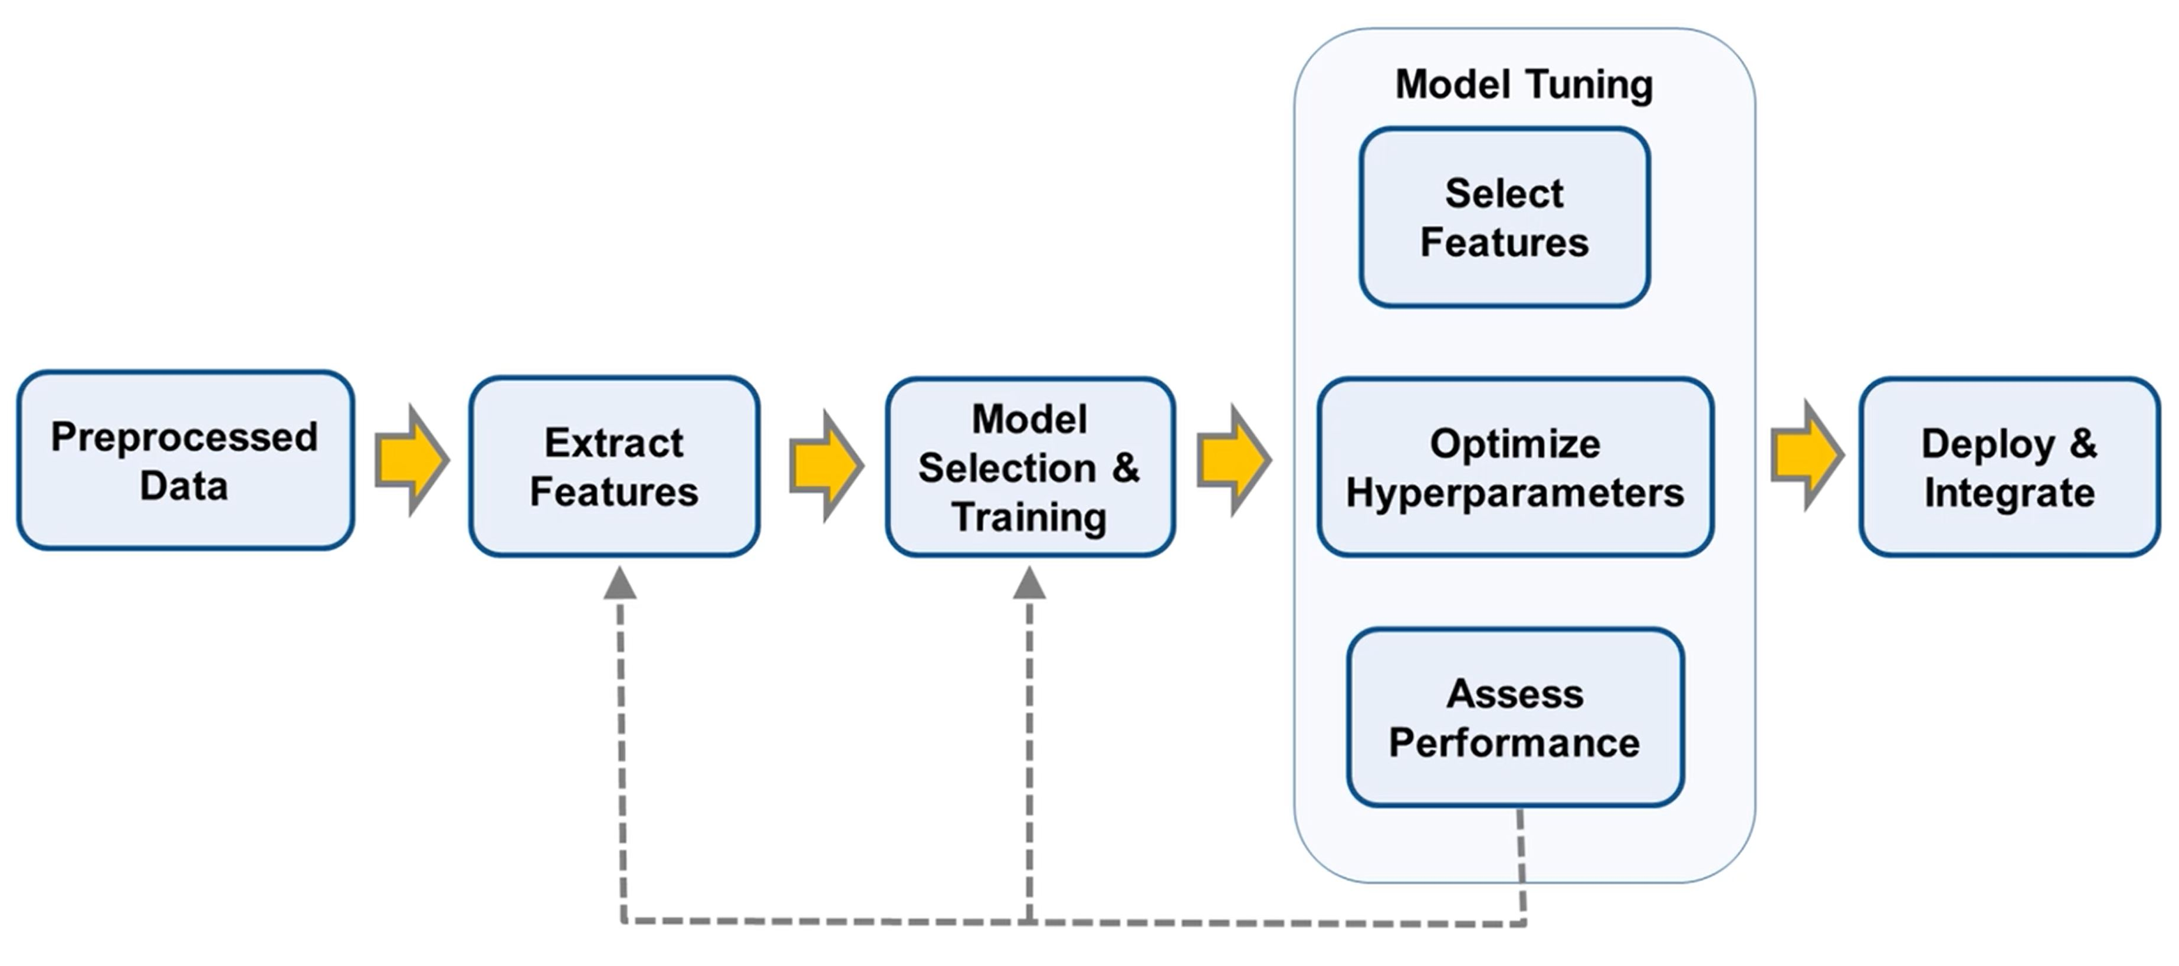
The work flow

Slide 7
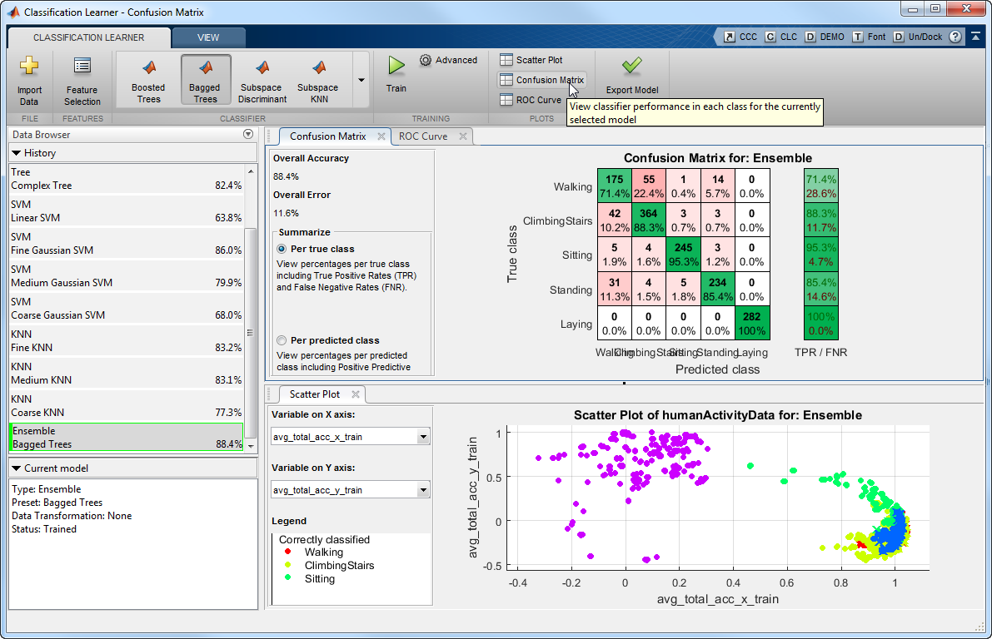
Classification Learner App
Classification Learner is a new app in the statistics and machine learning tool box that lets you train models to classify data using supervised machine learning.
Classification Learner lets you perform common machine learning tasks, such as:
importing data
specifying validation schemes
interactively exploring your data
selecting features
training models
assessing model performance

Slide 8
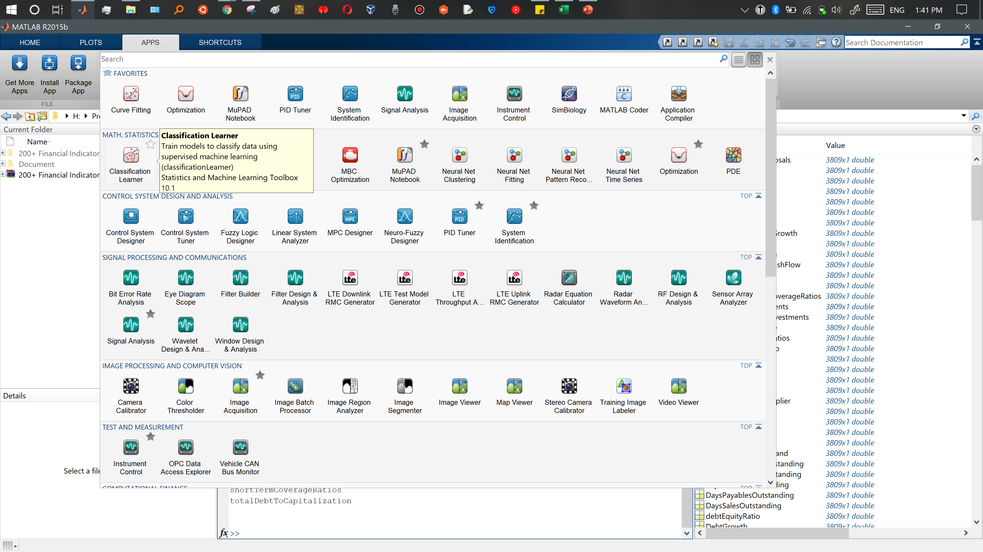
Classification Learner App

Slide 9
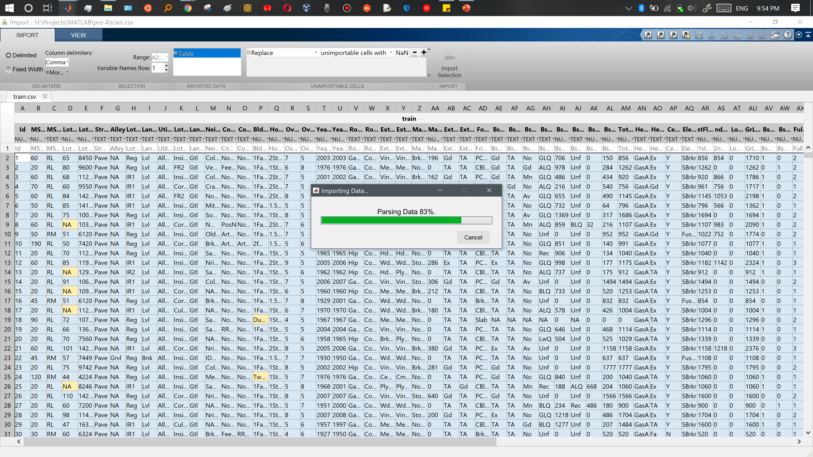
Selecting and importing data

Slide 10
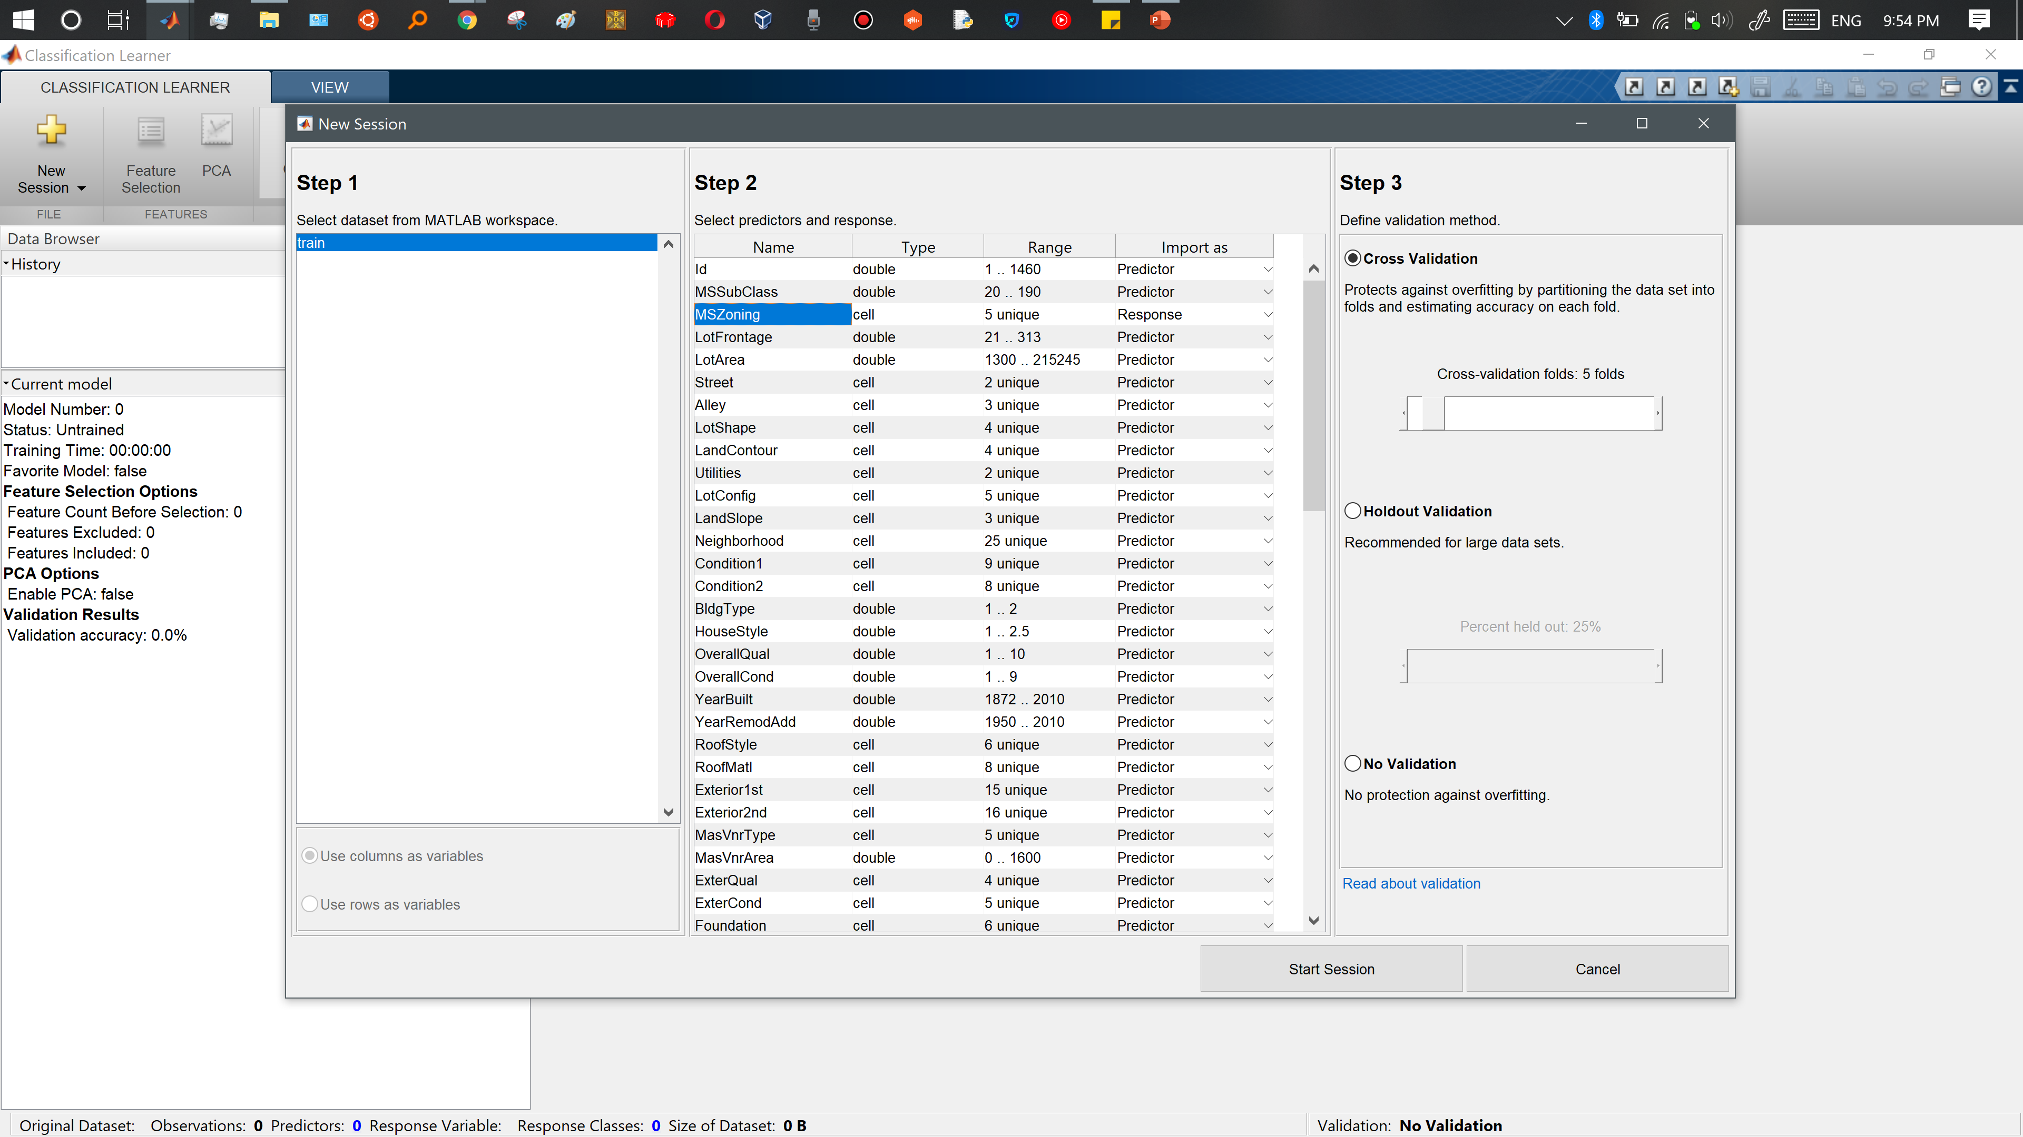
Predictors and responses

Slide 11
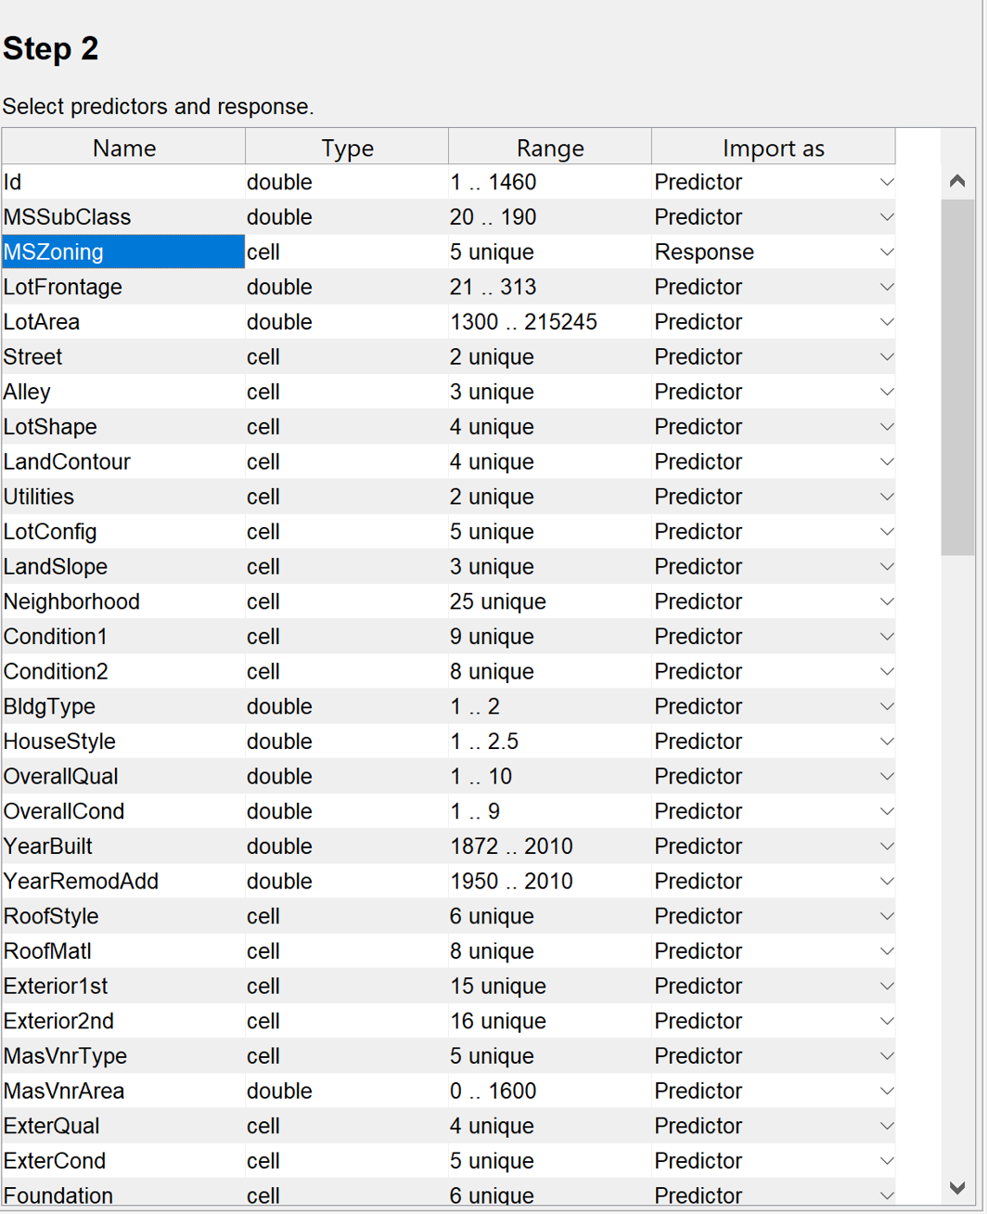
Predictors and responses
Predictors are the features that we use to classify them into the respective classes.
The response indicated here is the parameter into which we will classify the data.

Slide 12
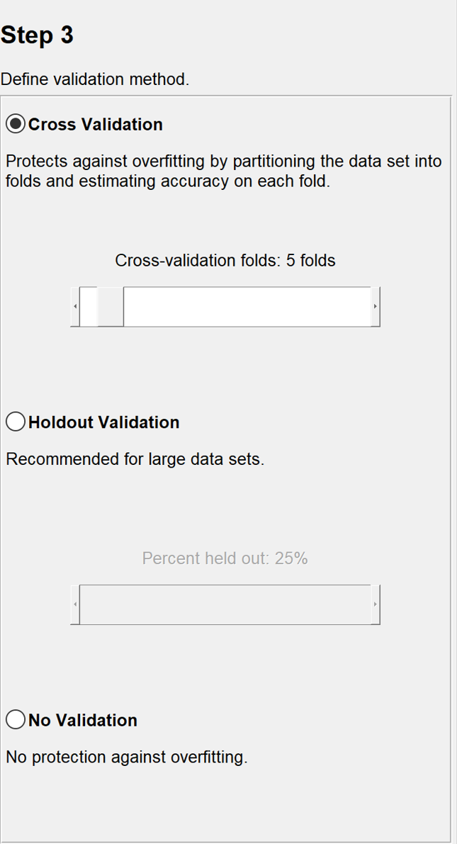
VALIDATION
Validation: the training data is divided into training and validation parts.
The validation part is used to check the trained model before testing to see that the model doesn’t get overfitted.
Cross-Validation
In this, the number of folds is the number of parts the training data will randomly divide. One part of it will be used for validation and the remaining for training.
Holdout Validation
We can select the percentage of data held out as a testing dataset and the remaining for training. This is usually recommended for large datasets.

Slide 13
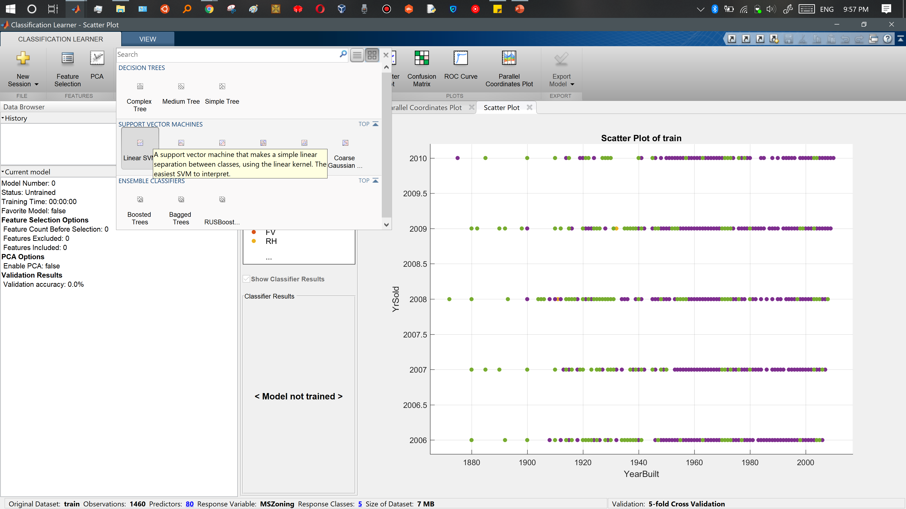
Classification Learner App

Slide 14
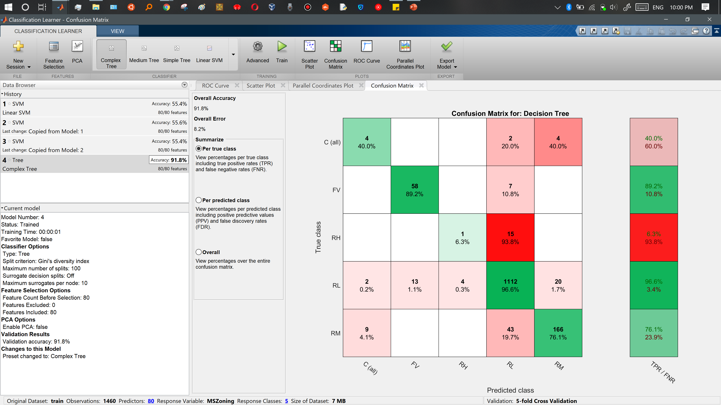
Confusion matrix

Slide 15
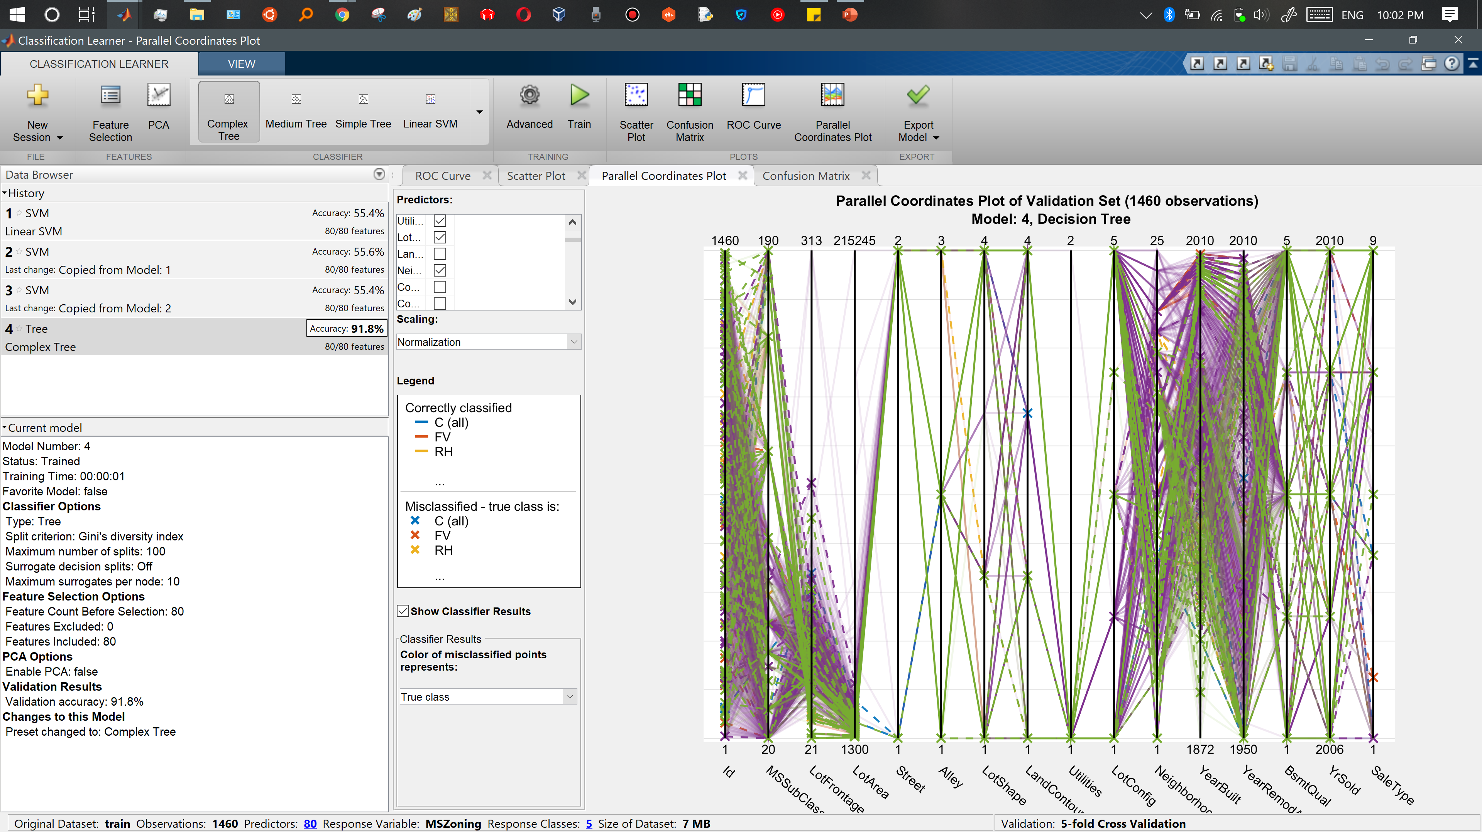
Parallel coordinates plot of validation set

Slide 16
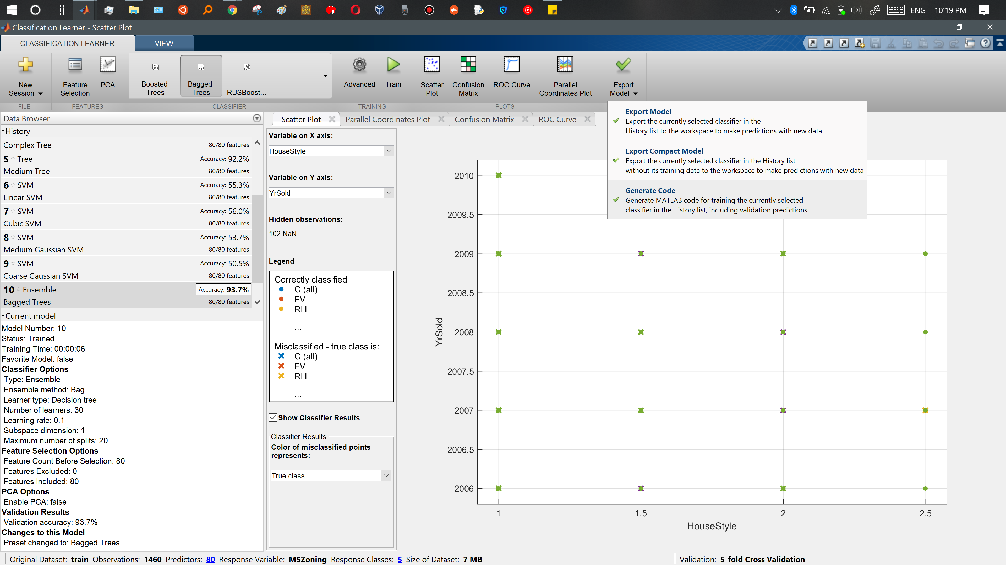
Export model and generate code

Slide 17
Sources and linkes
Source :
https://www.mathworks.com/help/stats/classificationlearner-app.html
https://matlabhelper.com/blog/matlab/classification-learner-app-in-matlab/
https://www.youtube.com/watch?v=3YGtxY67bq0
https://www.kaggle.com/anniepyim/essential-classification-algorithms-explained

Slide 18

Thank You
Pouya mehrbabak

